Slide 1
HPE GET MORE TOUR
October - December 2019

Slide 2

Registration Quiz
www.tinyurl.com/hpegmt
Password: HPEgmt

Slide 3
Agenda
09:30
Welcome and introduction: Partnering with HPE
09:45
Address your customer’s workload challenges
10:30
Break
10:40
Keep your customers’ business running
11:15
Winning with HPE
11:40
Break
11:50
Customer Conversations
12:30
Close

Slide 4
Objective
To support you and your customers in the SMB sector
Develop customer relationships by addressing their business outcomes based on HPE solutions
Learn how to use the HPE Tools
Benefit from the HPE Top Value Offers

Slide 5
Address your customer’s workload challenges

Slide 6
Customer Challenges & Workloads
What are your customers most common IT related challenges?
What are the typical customer workloads?

Slide 7
Expected answers
Challenges
Workloads
Budget – Top Value, Financial Solutions
Lack of experience -
Lack of experts
Need for innovation – SMB Solutions
Agility - SMB Solutions
Security - SMB Solutions
Consolidation - SMB Solutions
High running costs - SMB Solutions
Link it to 4 business outcomes:
Keep the business running
Improve productivity
Increase IT efficiency
Enhance the customer experience
File & print
Database
Virtualization
Cloud
Hybrid cloud/virtualization
Small Office Deployment
Wireless/networking
Storage
Drive it into 3 categories:
Run applications
Connect people
Store Data

Slide 8



HPE listened to our SMB customers
What do you really need from your IT?
I will fear no technology.
No worries, safe and secure.
Wow, that was efficient.
Customers are my business, not IT
I expect IT to work.
I need IT to improve my business.
I need IT advice.
I need to keep IT up and running.
I don’t have the luxury of downtime
I need complete solutions.
I need IT to be rock-solid reliable.
I need protection from cyberthreats.
I need hassle-free technical support.
Getting the best return is vital
I need IT to be fully utilized.
I’ll pay the right price for the best.
I want to purchase on my terms.
I prefer to pay only for what I use.
Notes:
Here at HPE, we’ve been listening to SMB customers, working to understand your challenges and help you meet your goals. What we’ve found is that most SMB customers have three main needs or goals around IT. Maybe some of these sound familiar to you.
Fear-free IT
You don’t want to be afraid of IT. Customers are your business, not IT. You expect IT to work, to help improve the business not create fear about new technology. You need to grow revenue and the business, so you sometimes need advice on what you need and how to keep it up and running with minimal fuss.
No worries, IT is safe and secure
You don’t want to worry about IT being safe and secure. And you don’t have the luxury of downtime. You expect an IT vendor to provide a complete solution, one that is rock-solid reliable, protected from cyberthreats, and has the technical support you need without the hassle of guesswork and hand-offs to multiple support people.
Amazingly efficient IT
You need IT to be efficient. Getting the best return for the money spent—on anything—is vital. You need to know that everything is being fully utilized and not dragging the business down because it’s outdated or inefficient. In fact, you’ll pay the right price to have the best IT for your business, but you want to do it on your terms and prefer to pay only for what you use.

Slide 9
The HPE approach
Giving you what you need to succeed
“Your customers are the heart of your business, your primary concern. You can trust HPE and our partners to take care of your IT so that you can take care of your customers.”
Focus on customers,
knowing your IT needs are taken care of
Sleep well at night with
360-degree security
Be confident that you are operating with maximum efficiency
No worries: Expert ecosystem of technologists
Confidence: Configured, tested, and validated solutions
Hands-free: Automated infrastructure deployment and management
Cloud-ready: Easily add on to on-premises solutions
Protect: With the world’s most secure industry-standard servers
Shield: Sensitive information from cyber threats
Avoid downtime: Continuous business operations
Control access: To vital business data
Save time and money: Fewer resources required to manage IT
No-nonsense value pricing: Flexible, more predictive financing
Pay-as-you-grow: HPE Financial Services
Notes:
They also help you keep things simple, secure, and affordable.
Most SMB customers are not IT-savvy, and they rely completely on their Partners. Our job at HPE is to make it easy on our Partners to deploy solutions that deliver these outcomes. HPE Small Business Solutions capture best practices and incorporate the latest technologies that are optimized for top SMB use cases. The solutions are targeted to enable Partners to deploy solutions at reduced cost and increase customer SLAs, which results in increased margin and higher customer retention. Partners are looking to get greater efficiencies from their employees. HPE Small Business Solutions are accompanied by a solution guide and training materials that can be easily consumed.
These configured and validated solutions are prescriptive yet highly customizable, making them easy for Partners to sell. They are also designed to be simple, secure, and affordable, which brings a host of benefits both for customers and Partners.
Main points:
SIMPLE
Fewer SKUs
Reducing the number of SKUs to manage from 632 to 63 (90% reduction)
Same SKUs for all segments, all programs
HPE SMB Offers leverage standard BTO SKUs and are eligible for deal registration through local programs.
Assembly on behalf of HPE
Currently WIP for European geos
iQuote
Frictionless: Predesigned configurations at pre-approved discounts, fully managed under iQuote
SECURE
Silicon root of trust
Security is top of mind for SMBs. They’ll want to know more about HPE silicon root of trust technology—with built-in features that make HPE ProLiant Gen10 the world’s most secure industry-standard servers.¹
AFFORDABLE
Benchmarked aggressive pricing
HPE SMB Offers are more aggressive than standard promo SKUs (5–7% on top-selling SKUs)
Flexibility to adjust configuration and price
With HPE SMB Offers, HPE is able to instantly react to competitive attack and aging stock
HPE demand generation
$4–5M HPE SMB Offers demand generation
Incentives for Partners, ISRs, iPBMs
Leverage Engage&Grow to promote HPE SMB Offers, incentivize iPBMs and ISRs for promo
Future: Distributor-specific offers
To support the distributor-specific programs
¹ Based on external firm conducting cyber security penetration testing of a range of server products from a range of manufacturers, May 2017. Because the MicroServer does not have iLO5, silicon root of trust is not available for the MicroServer Gen10.

Slide 10

What is HPE doing to help Channel Partners?
Simple
Secure
Affordable
Aggressively low price
90%
#Gen10
Server and option SKUs
Silicon root of trust
Engage&Grow incentives
Notes:
They also help you keep things simple, secure, and affordable.
Most SMB customers are not IT-savvy, and they rely completely on their Partners. Our job at HPE is to make it easy on our Partners to deploy solutions that deliver these outcomes. HPE Small Business Solutions capture best practices and incorporate the latest technologies that are optimized for top SMB use cases. The solutions are targeted to enable Partners to deploy solutions at reduced cost and increase customer SLAs, which results in increased margin and higher customer retention. Partners are looking to get greater efficiencies from their employees. HPE Small Business Solutions are accompanied by a solution guide and training materials that can be easily consumed.
These configured and validated solutions are prescriptive yet highly customizable, making them easy for Partners to sell. They are also designed to be simple, secure, and affordable, which brings a host of benefits both for customers and Partners.
Main points:
SIMPLE
Fewer SKUs
Reducing the number of SKUs to manage from 632 to 63 (90% reduction)
Same SKUs for all segments, all programs
HPE SMB Offers leverage standard BTO SKUs and are eligible for deal registration through local programs.
Assembly on behalf of HPE
Currently WIP for European geos
iQuote
Frictionless: Predesigned configurations at pre-approved discounts, fully managed under iQuote
SECURE
Silicon root of trust
Security is top of mind for SMBs. They’ll want to know more about HPE silicon root of trust technology—with built-in features that make HPE ProLiant Gen10 the world’s most secure industry-standard servers.¹
AFFORDABLE
Benchmarked aggressive pricing
HPE SMB Offers are more aggressive than standard promo SKUs (5–7% on top-selling SKUs)
Flexibility to adjust configuration and price
With HPE SMB Offers, HPE is able to instantly react to competitive attack and aging stock
HPE demand generation
$4–5M HPE SMB Offers demand generation
Incentives for Partners, ISRs, iPBMs
Leverage Engage&Grow to promote HPE SMB Offers, incentivize iPBMs and ISRs for promo
Future: Distributor-specific offers
To support the distributor-specific programs
¹ Based on external firm conducting cyber security penetration testing of a range of server products from a range of manufacturers, May 2017. Because the MicroServer does not have iLO5, silicon root of trust is not available for the MicroServer Gen10.

Slide 11
HPE Small Business Solutions
Overview
Notes:
So how does that translate into the HPE Small Business Solutions? Let’s take a look.

Slide 12
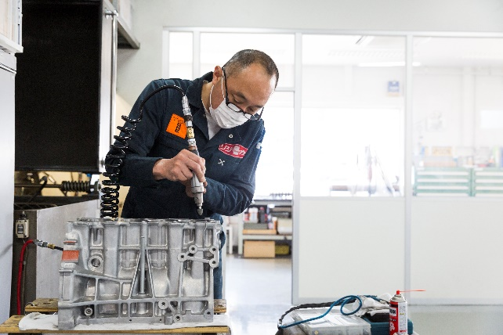



The right IT can help you achieve key business goals
Keep the business running
Improve productivity
Increase IT efficiency
Enhance the customer experience
Notes:
Based on the goal of deploying IT that helps you with your customers, your business, and your focus, we developed a portfolio of workload-optimized configurations designed to help you keep the business running, improve employee productivity, increase IT efficiency, and enhance the customer experience.
Business Outcome
Keep the business running
Result
Less downtime, Disaster Recovery
For examples
HA Storage, Backups
Business Outcome
Improve productivity
Result
Improved performance and accessibility to data and apps (i.e. local and remote)
For examples
File Sharing, Application Hosting
Business Outcome
Increase IT efficiency
Result
Higher utilization of hardware, do more with less hardware thus reducing cost of IT
For examples
Virtualization, Containers
Business Outcome
Virtualization, Containers
Result
Customer facing and internal apps, and supporting network, perform better and are more reliable resulting in improved and reliable customer interaction
For examples
HPE Solutions

Slide 13



HPE Small Business Solutions
Your customer, your business, your focus
Store data
Run applications
Connect people
“No worries, safe and secure”
“Wow, that was efficient”
“I will fear no IT”
File and Backup
Hybrid File and Backup
Scalable Storage
High Availability Storage
Virtualization
Hybrid Virtualization
Hybrid Database
Small Office Deployment
Notes:
Expert features and capabilities
Ready for applications without headaches
Secure by design with new iLO 5 features
Predicts and prevents problems before customers’ businesses are impacted with HPE Infosight
11% per-core performance gain with second-generation Intel® Xeon® Scalable processor
Leading industry-standard benchmarks for energy efficiency and performance in the ML and DL 300 series servers
Supports mixed drive cages within the same server for tiered storage in HPE ProLiant ML350 Gen10
Choice and value with enhanced portfolio
Expanding choice with low-cost 2P secure servers to SMBs with the ProLiant DL160 and DL180 Gen10 Servers
Same easy to manage tools like HPE Intelligent Provisioning, HPE Service Pack for ProLiant (SPP), and HPE Scripting Tools for Windows PowerShell
Qualified and shared options across the DL portfolio
Toolkits for accelerated deployment
Step-by-step and best practices built into the solutions deployment guide for foolproof solutions
Automated, guided, and faster out-of-the box single-server deployment with Rapid Setup software, now integrated with Intelligent Provisioning
Migration techniques to Microsoft® Windows Server® 2019, plus Microsoft ROK available from HPE.

Slide 14


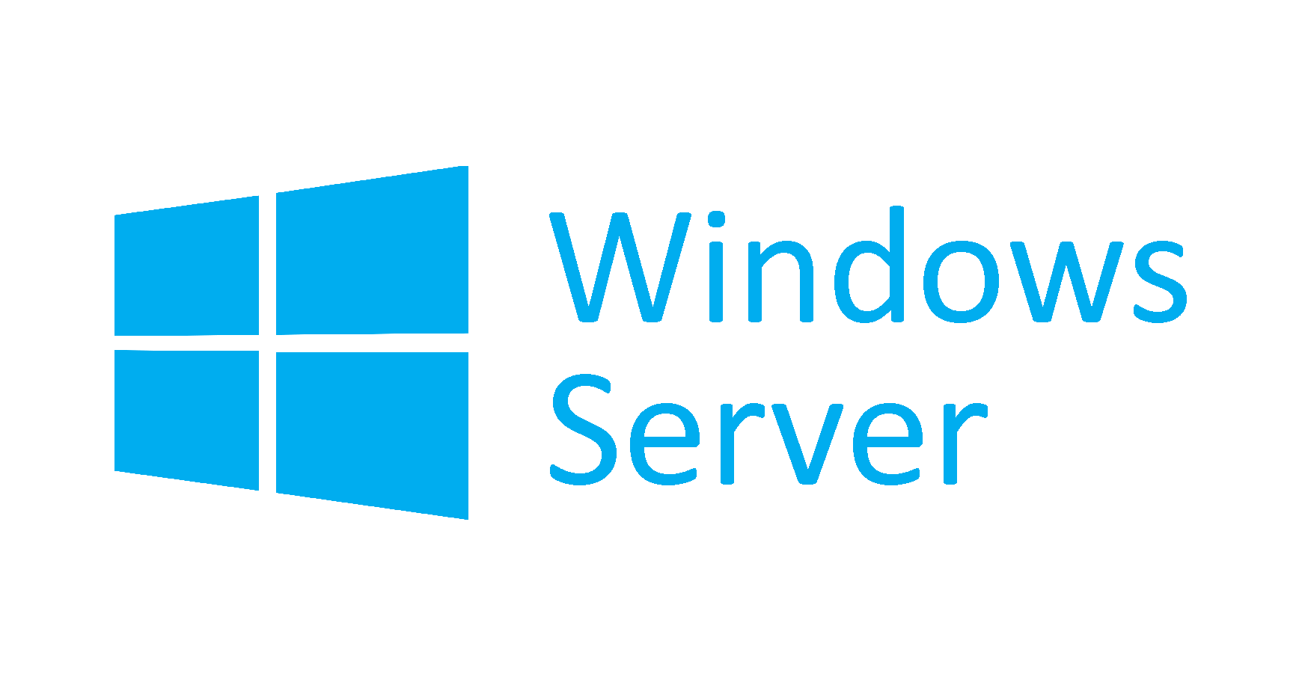



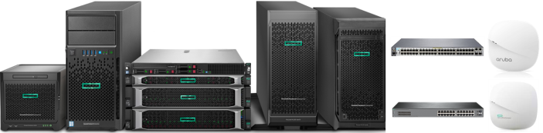
Start with complete, validated hardware and software stacks
Software-defined storage
Microsoft Azure Stack HCI
(Microsoft Storage Spaces Direct)
vSAN™
Hypervisor
ESXi™
Operating system (OS)
Hardware management
Aruba Central
Office Connect Mobile App
iLO Advanced
Hardware
Notes:
Now, let’s take a closer look at how we build these solutions. This image shows the basic components of on-premises HPE Small Business Solutions.
For these solutions, you have choice of operating system: either ClearOS® (a high-value, low-cost OS platform and solution software based on Linux®) or Microsoft Windows Server® (today’s most popular SMB environment).
If you choose a virtualization solution, you have a choice of hypervisor: ClearVM®, Microsoft Hyper-V®, or VMware® vSphere®.
If you choose high-availability storage enabled by software-defined storage, you have a choice of Microsoft Storage Spaces Direct or VMware vSAN™.
And HPE Small Business Solutions for Small Office Deployment offer a choice between Aruba and HPE Office Connect switches and wireless access points.
They also include a variety of server options and service and support choices.
These solutions can also be scaled to grow with the organization, by adding memory and storage.

Slide 15
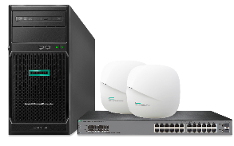
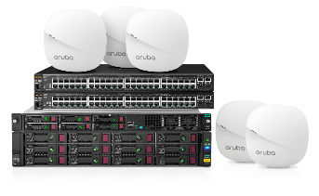
HPE Small Business Solutions for Small Office Deployment
Set up IT in a snap
First office
With expanded storage
1–25 employees (2 client devices per employee)
HPE ProLiant ML30 Gen10 HPE OfficeConnect 1920s 2 x HPE OfficeConnect OC20
1–100 employees (2 client devices per employee)
HPE ProLiant DL20 Gen10 HPE StoreEasy 1660 2 x Aruba 2530 5 x Aruba iAP 303
Configured, tested, and validated with HPE Pointnext Foundation Care support and flexible payment options from HPE Financial Services
Notes:
Set up IT in a snap. These complete solution bundles combine the performance, management, reliability, and security features of HPE ProLiant Gen10 servers, powered by Intel; HPE or Aruba wired and wireless networking with smart management tools; and the peace of mind of HPE Foundation Care. Validated HPE Small Business Solutions converge multiple functions such as virtualization, storage, and backup onto a single server for a simple, secure, and affordable IT infrastructure.

Slide 16
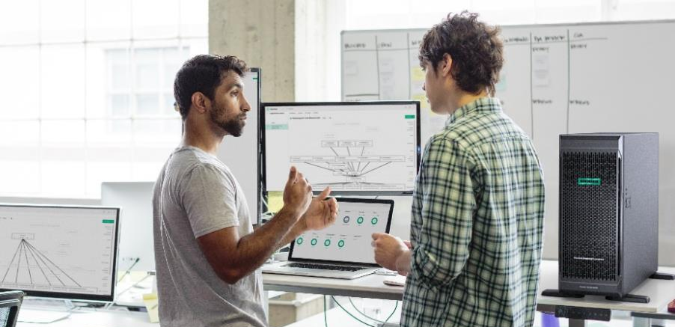



HPE Small Business Solutions for Virtualization
UPDATED
Run more applications efficiently
Dramatically increase server utilization
Quickly add applications and resources
Ensure data and application availability
HPE ProLiant Gen10 300, 100, 10 series servers, 1–8 VMs
Running either Microsoft Hyper-V® or VMware® ESXi™
Veeam® Enterprise Backup & Replication™ (optional)
Hybrid Cloud ready: Colocation/data center and Microsoft Azure
Configured, tested, and validated with HPE Pointnext Foundation Care support and flexible payment options from HPE Financial Services
Notes:
Set up IT in a snap. These complete solution bundles combine the performance, management, reliability, and security features of HPE ProLiant Gen10 servers, powered by Intel; HPE or Aruba wired and wireless networking with smart management tools; and the peace of mind of HPE Foundation Care. Validated HPE Small Business Solutions converge multiple functions such as virtualization, storage, and backup onto a single server for a simple, secure, and affordable IT infrastructure.

Slide 17
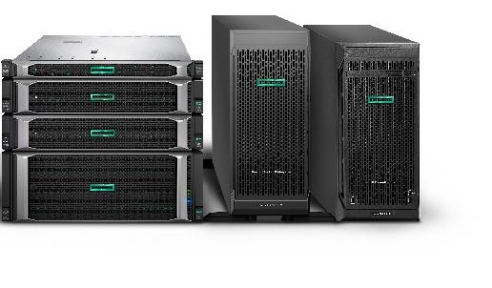
HPE Small Business Solutions for Hybrid Database
Flex your database
Maintain data availability with automatic replication to the cloud
Scale size, performance, and costs on demand
Segment your database based on the sensitivity of your files
HPE ProLiant Gen10 300, 100, and 10 series servers
Supports 1–251+ users
Configured, tested, and validated with HPE Pointnext Foundation Care support and flexible payment options from HPE Financial Services
Notes:
Set up IT in a snap. These complete solution bundles combine the performance, management, reliability, and security features of HPE ProLiant Gen10 servers, powered by Intel; HPE or Aruba wired and wireless networking with smart management tools; and the peace of mind of HPE Foundation Care. Validated HPE Small Business Solutions converge multiple functions such as virtualization, storage, and backup onto a single server for a simple, secure, and affordable IT infrastructure.

Slide 18
Small Office Deployment Demonstration
Demo and hands-on exercise

Slide 19
Keep your customer’s business running

Slide 20
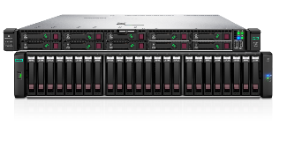
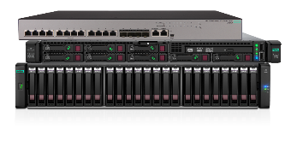
HPE Small Business Solutions for Scalable Storage
Reduce storage costs with resilient, sharable, and expandable external storage
Affordable scalable storage
High-performance scalable storage
50–150 employees
HPE ProLiant DL360 Gen10 MSA 1050 SAS SFF
150–250 employees
HPE ProLiant DL325 Gen10 Servers (two or more required for failover)
MSA 2052 SAN SFF OfficeConnect 1950 12XGT 4SF (optional)
Can be deployed in colocations/data centers or on-premises
Configured, tested, and validated with HPE Pointnext Foundation Care support and flexible payment options from HPE Financial Services
Notes:
HPE Small Business Solutions for Scalable Storage
Expand as needed. External storage allows you to extend storage capacity without purchasing additional servers—maintaining budget for more pressing matters. HPE Small Business Solutions for Scalable Storage starts with an HPE ProLiant server, optimized and validated to run Microsoft Windows Server. You can choose from entry-level or high-performance scalable storage configurations based on HPE MSA storage. Whether you need a low-cost option for file serving and archival storage or high performance scalable storage to speed database performance, HPE has what you need to thrive.

Slide 21
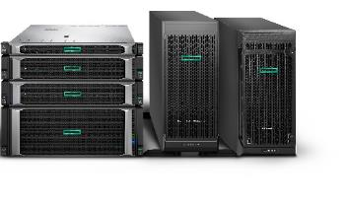
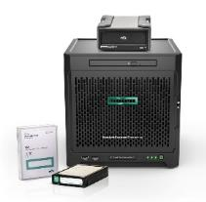
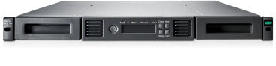
HPE Small Business Solutions for File and Backup
Centralize, backup, and protect files
File and backup
External backup
File archive
1–250+ employees
Centralize files
Choice of HPE ProLiant Gen10 servers
10–100 employees
Portable storage
RDX external disk
Recommended option
50–250+ employees
Regulatory compliance
StoreEver 1/8 Autoloader
Recommended option
Hybrid Cloud ready: Colocation/data center and Microsoft Azure®
Configured, tested, and validated with HPE Pointnext Foundation Care support and flexible payment options from HPE Financial Services
Notes:
HPE Small Business Solutions for File and Backup
Maintain your momentum. HPE Small Business Solutions for File and Backup with Microsoft Windows Server offers features such as centralized storage and security, data protection, 24x7 availability, and optional archiving and disaster recovery storage solutions help keep the business running and improve employee productivity.
Enhance peace of mind with recommended storage options for archiving and disaster recovery
HPE RDX Removable Disk Backup System is a reliable, disk-based backup and recovery solution with unmatched portability, fast recovery, and easy integration into HPE Small Business Solutions for File and Backup.
HPE StoreEver MSL 1/8 Tape Autoloader meets demanding storage requirements for businesses needing unattended backup, disaster recovery, or archive capability that integrate with HPE Small Business Solutions for File and Backup.
HPE Small Business Solutions for Hybrid File and Backup
HPE Small Business Solutions for Hybrid File and Backup start with the same on-premises features as HPE Small Business Solutions for File and Backup to help protect the business, increase efficiency and productivity, and save time and money.
Adding Microsoft Azure Services creates a hybrid file and backup solution that enables a simple yet robust business continuity plan. The solution uses Azure Files, Azure File Sync, and Azure Backup with the on-premises HPE ProLiant server to automatically copy files both to Azure Files in the cloud and the HPE ProLiant server at the office. And data is encrypted at rest and in motion for security and compliance.

Slide 22

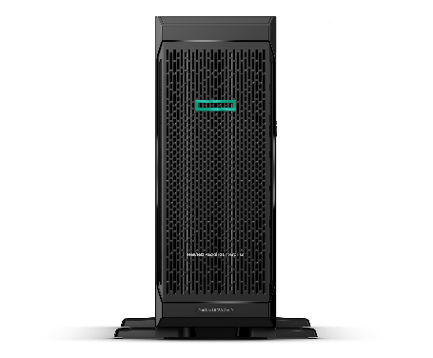
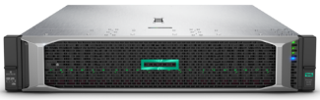
HPE Small Business Solutions for High Availability Storage
Store data—securely and efficiently—with software-defined storage
Microsoft Azure Stack HCI (formerly WSSD)¹
Microsoft Azure Stack HCI (formerly WSSD)¹
VMware vSAN®
HPE ProLiant ML350 Gen10 Servers
HPE ProLiant DL38x Gen10 Servers
HPE ProLiant DL38x Gen10 Servers
6 VMs per node²
8 VMs per node²
8 VMs per node²
Configured, tested, and validated with HPE Pointnext Foundation Care support and flexible payment options from HPE Financial Services
¹ Microsoft Azure Stack HCI is available in Windows Server 2019 Datacenter. Windows Storage Server Direct is available in Windows Server 2016 Datacenter.
² 2-node solutions require an additional witness host that is separate from the storage solution; can support up to 16 nodes for Windows and up to 64 nodes for VMware.
Notes:
Simplify and expand storage. Virtualize local server storage to create a low-cost, scalable, software-defined storage solution that’s simple to deploy, manage, and support. Built-in resilience handles drive, server, or component failures with continuous availability. Solutions support both Microsoft Azure Stack HCI and VMware vSAN.
Business Outcome
Keep the business running
Result
Less downtime, Disaster Recovery
For examples
HA Storage, Backups
Business Outcome
Improve productivity
Result
Improved performance and accessibility to data and apps (i.e. local and remote)
For examples
File Sharing, Application Hosting
Business Outcome
Increase IT efficiency
Result
Higher utilization of hardware, do more with less hardware thus reducing cost of IT
For examples
Virtualization, Containers
Business Outcome
Enhance the customer experience
Result
Customer facing and internal apps, and supporting network, perform better and are more reliable resulting in improved and reliable customer interaction
For examples
HPE Solutions

Slide 23
Match the cards
Match the title with the descriptions

Slide 24
Building a better IT experience
HPE Differentiators

Slide 25
HPE Intelligent Provisioning now with SMB Setup
An automated out-of-the-box, single-server deployment
Simple
Time saving
Cost saving
Single interface eliminates the need to learn multiple tools
Guided process reduces the chance for errors
Pre-loaded firmware, drivers, and tools are ready to deploy at the command
Embedded inside all HPE ProLiant servers
50% faster migrations¹
33.3% faster installs²
Complete more migrations and installs in the same timeframe
Supports Microsoft Windows Server 2019
Save money by enabling entry-level technicians to perform installations and deployments
Save time on server deployment
SMB Setup was formerly called Rapid Setup Software
¹ Reduces time to migrate an existing server to a new OS from 24 hours to just 12. Source: HPE internal testing with SMB Setup, October 2018.
² Reduces time to install and setup a new server from six hours to just four. Source: HPE internal testing with SMB Setup, October 2018.
Notes:
Simplify and expand storage. Virtualize local server storage to create a low-cost, scalable, software-defined storage solution that’s simple to deploy, manage, and support. Built-in resilience handles drive, server, or component failures with continuous availability. Solutions support both Microsoft Azure Stack HCI and VMware vSAN.
Business Outcome
Keep the business running
Result
Less downtime, Disaster Recovery
For examples
HA Storage, Backups
Business Outcome
Improve productivity
Result
Improved performance and accessibility to data and apps (i.e. local and remote)
For examples
File Sharing, Application Hosting
Business Outcome
Increase IT efficiency
Result
Higher utilization of hardware, do more with less hardware thus reducing cost of IT
For examples
Virtualization, Containers
Business Outcome
Enhance the customer experience
Result
Customer facing and internal apps, and supporting network, perform better and are more reliable resulting in improved and reliable customer interaction
For examples
HPE Solutions

Slide 26
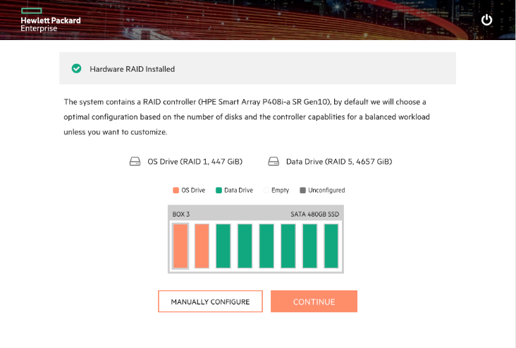
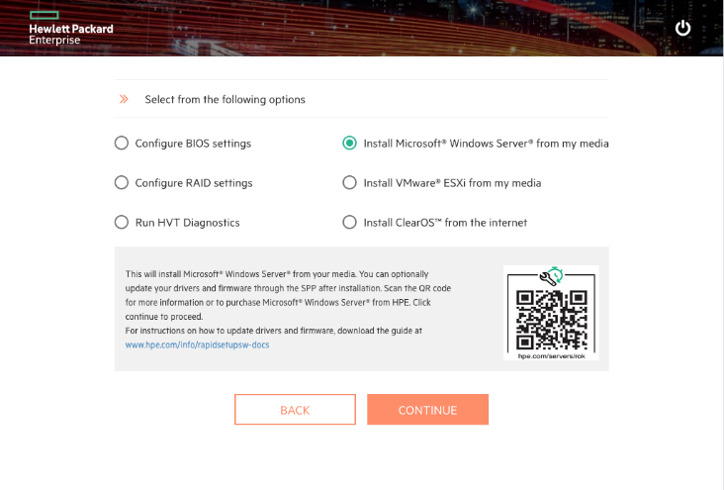
SMB Setup—automated server/OS deployment¹
Embedded in ProLiant Gen10 servers²
Simple three-step process
Setup hardware RAID
Select OS drive target
Select and install the OS or hypervisor
Optional hardware configuration (BIOS, HVT, RAID)
New or enhanced features
Automated RAID configuration for servers with five or more drives
Enhanced manual RAID configuration option
Enhanced server drive GUI
ClearOS internet install
Windows Server 2019 support
¹ Part of Intelligent Provisioning. Replaces Rapid Setup Software.
² Embedded in ProLiant 10, 100, and 300 series Gen10 servers.
Notes:
Simplify and expand storage. Virtualize local server storage to create a low-cost, scalable, software-defined storage solution that’s simple to deploy, manage, and support. Built-in resilience handles drive, server, or component failures with continuous availability. Solutions support both Microsoft Azure Stack HCI and VMware vSAN.
Business Outcome
Keep the business running
Result
Less downtime, Disaster Recovery
For examples
HA Storage, Backups
Business Outcome
Improve productivity
Result
Improved performance and accessibility to data and apps (i.e. local and remote)
For examples
File Sharing, Application Hosting
Business Outcome
Increase IT efficiency
Result
Higher utilization of hardware, do more with less hardware thus reducing cost of IT
For examples
Virtualization, Containers
Business Outcome
Enhance the customer experience
Result
Customer facing and internal apps, and supporting network, perform better and are more reliable resulting in improved and reliable customer interaction
For examples
HPE Solutions

Slide 27
HPE InfoSight for Servers
HPE InfoSight brings artificial intelligence to HPE ProLiant servers*
Predictive Analytics
Data analytics for server security
Predictive data analytics for parts failure
Global Learning
Server Wellness Dashboard
Global inventory of servers
Performance and utilization graphs
Recommendation
Engine
Recommendations to eliminate performance bottlenecks on servers
*HPE ProLiant servers Gen10, Gen9, and Gen8 with iLO 5 and iLO 4
.
27
Notes:
Simplify and expand storage. Virtualize local server storage to create a low-cost, scalable, software-defined storage solution that’s simple to deploy, manage, and support. Built-in resilience handles drive, server, or component failures with continuous availability. Solutions support both Microsoft Azure Stack HCI and VMware vSAN.
Business Outcome
Keep the business running
Result
Less downtime, Disaster Recovery
For examples
HA Storage, Backups
Business Outcome
Improve productivity
Result
Improved performance and accessibility to data and apps (i.e. local and remote)
For examples
File Sharing, Application Hosting
Business Outcome
Increase IT efficiency
Result
Higher utilization of hardware, do more with less hardware thus reducing cost of IT
For examples
Virtualization, Containers
Business Outcome
Enhance the customer experience
Result
Customer facing and internal apps, and supporting network, perform better and are more reliable resulting in improved and reliable customer interaction
For examples
HPE Solutions

Slide 28

HPE ILO5
Configuration and Monitoring
Insure secure transit and locks server hardware configuration
Remote Management
Detect and address possible security vulnerabilities in current server setup
Workload Performance Advisor
Server tuning recommendations to improve server performance
NEW
Notes:
This was touched on in the video as well, but it bears repeating that these offers are available in “good … better … best” configurations.
Entry offers are aggressively priced against the competition for merchandising to drive to a higher performance offer and eventually as a solution.
Performance offers are the most likely configurations customers will buy – they are richer in hard drives and memory. These are the Sweet Spot of configurations.
Then we have HPE Small Business Solutions, which are targeted for specific workloads.
SMB Offer Elements are top-selling options with the marriage of the base server SKU providing a ready-to-go workload offering with the best discounts.
Now let’s take a look at an actual example for one of our most popular tower servers.

Slide 29
HPE Top Value
Entry offers
Top Value Elements
Top selling HPE ProLiant options added to HPE ProLiant server SKU for ready-to-go workloads
Performance offers
Solutions offers
Notes:
This was touched on in the video as well, but it bears repeating that these offers are available in “good … better … best” configurations.
Entry offers are aggressively priced against the competition for merchandising to drive to a higher performance offer and eventually as a solution.
Performance offers are the most likely configurations customers will buy – they are richer in hard drives and memory. These are the Sweet Spot of configurations.
Then we have HPE Small Business Solutions, which are targeted for specific workloads.
SMB Offer Elements are top-selling options with the marriage of the base server SKU providing a ready-to-go workload offering with the best discounts.
Now let’s take a look at an actual example for one of our most popular tower servers.

Slide 30
The HPE TOP value OFFERS for Partners
Increase revenue and margins
Enhance customer SLAs
Accelerate sales cycles with easy ordering and deployment
Offer customers the lowest pre-approved price and subscription options
Offer ready-to-go solutions, optimized for top SMB workloads
Deliver new services
Create competitive differentiation with value-added services and financing
Reduce complexity and increase efficiency
Sell pre-configured solutions that are in stock and ready to ship
Speed deployment and free up resources with simple configuration and installation
Keep up with the latest technology
Choose from a focused set of best-selling solutions based on the latest technologies
Notes:
That’s why we’ve created SMB Offers. They help you…
/refer to slide points/

Slide 31


Beyond Foundation Care: HPE Pointnext portfolio
Peace of mind
Improve reliability
Achieve efficiencies
Reduce financial burden
Focus on business development
Foundation Care
Proactive Care
Proactive Care Advance
Datacenter Care
Advise and plan
Deployment
Integrate and migrate
Operate and improve
Retire and sanitize
Management of Change
Technical Training Courses
Digital Learner Subscription
Operational support services
Advisory and professional services
Education
services
Notes:
HPE Pointnext services
A services partner built for your business today and tomorrow, HPE Pointnext services enable you to meet availability commitments with a variety of coverage levels and response times, and easily connect to HPE for faster problem resolution.
HPE Pointnext offers comprehensive hardware and software services to help increase the availability of IT infrastructure and extend in-house IT staff with HPE expertise. You can do more with less by leveraging service tools with built-in simplification, and remote management tools.
Improve reliability through proactive monitoring and operational support
Deliver better SLAs with faster parts replacement
Increase efficiency by leveraging HPE Education to keep up with the latest technologies and best practices
Reduce financial burden: HPE GreenLake provides the flexibility capacity and pay as you grow
Use these improvements to focus on business development
Operational support services
HPE Foundation Care is cost-effective, simplified support that helps get devices running when there is a problem. This is reactive support.
HPE Proactive Care includes everything that Foundation Care offers plus more personalized, proactive support with an enhanced call experience and tailored reports with recommendations. Proactive Care Advanced includes assigned technical experts for a more personalized experience.
HPE Datacenter Care offers a tailored experience to drive operational efficiency for the entire IT environment, even multivendor IT. Datacenter Care builds on Foundation Care and Proactive Care, plus offers an assigned account support team.
Education Services
HPE understands that technology adoption is better enabled when people within your organization are trained and equipped to work with the technology well. HPE Education Services offers a full range of training opportunities, ranging from on-demand and virtual labs to instructor-led, and inclusive of education consulting for a tailored fit to their specific needs and teams.

Slide 32

A new experience in simple, affordable IT
Accessing the best technology for your most sensitive data and applications
Trade in the old, make room for the new
Make a big transition easier
Simple to consume
Ship existing equipment back to HPE and get money back for the technology.
Securely retire and recover value from your old equipment. Our expertise gives you peace of mind.
Subscribe to a bundled technology solution for a predictable monthly payment.
HPE Transition Services
(for smaller projects)
HPE Transition Services (for larger/complex projects)
HPE Subscription
Notes:
Of course, with cost and efficiency being important concerns, HPE Financial Services is right there with a number of ways for you to get the IT you need now, while conserving cash for other critical needs.

Slide 33




HPE Small Business Solutions and HPE Subscription—Better together
A new experience in simple and affordable IT
HPE Subscription and Transition Services
Simple
Secure
Affordable
Eliminate complexity:
Fast credit approval
Simple contracts
Provide peace of mind:
Eliminates CAPEX burden
Better cash flow
Budget friendly:
Flexible monthly payment
Cost savings through trade-in
Notes:
You can also sell HPE SMB Offers as a subscription.
HPE Subscription services allow SMBs to select a complete solution from predefined options that include best-in-class software; accessories; compute, storage, and networking hardware; and worry-free support services for a predictable monthly subscription fee. No large, upfront purchase to make—just subscribe, use, return, and renew. No worries about what to do with old equipment.
Need to expand? Simply add more subscriptions. HPE Channel Partners can offer hardware, software, and support services in a single solution and deliver it in one simplified subscription contract.

Slide 34





Why Buy a MICROSOFT Reseller Option Kit?
Value
Simplified installation
Downgrade Rights
Simplest, most cost-effective license for many small and midsize businesses
Comes with no-charge 90-day warranty including installation support
Includes downgrade rights from Windows Server 2019 to Windows Server 2016
Warranty Cover From HPE
One Stop Shop
Windows Server Cash Back
HPE will offer the support required under the hardware warranty
For your Hardware, Operating System and CALs
Claim up to $500 cash back when you buy an HPE ProLiant with a qualifying Windows Server OS – Double that with a DL160/DL180!
Notes:
Value – most cost effective way to license compared to Volume licensing or COEM (Microsoft Vanilla)
Simplified Installation – Tried Tested and tuned to HPE ProLiant, results in a shorter install time and also has 90 days free installation support – meaning a customer can just call one number to get help.
Downfrade Rights – ROK is the only OS type for SMBs that offers downgrade rights to a previous version, for no extra cost.
Covered under hardware warranty – HPE will offer the support required should there be a warranty
issue.
One Stop Shop – shop with ease, with one point of contact.
Windows Server Cash Back - Claim up to $500 cash back when you buy an HPE ProLiant with a qualifying Windows Server OS – Double that with a DL160/DL180

Slide 35
Customer Scenarios
Which HPE solution would benefit the customer in these scenarios?

Slide 36
HPE Partner Tools
HPE Seismic
HPE iQuote
Top Value
PS Now
HPE Engage Portal

Slide 37
Customer conversations
Customer scenario

Slide 38
Feedback

Slide 39
Thank You

